Slide 1


ECEN 404
Bi-Weekly Update 2
Matrix 1 / “Scooter Juice”
Connor Cottongame
John Dusterhoff
Blake Hallam
Oscar Rubio
TA: Sabyasachi Gupta
Sponsor: Prof Prasad Enjeti

Slide 2

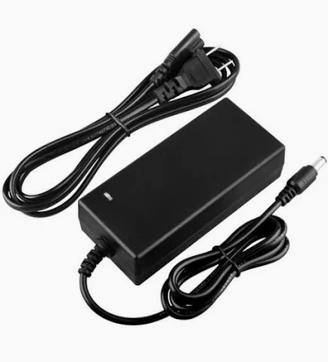

Project Summary
Problem statement:
Current electric scooter chargers are bulky and inconvenient to use, requiring large, external rectifiers to charge their batteries, much like a laptop charger.
Our Solution:
This team will design and build an IOBC (Integrated On-Board Charger), allowing the scooter to be charged directly from an AC power source.
This charger will use the existing inverter components in the scooter as a rectifier in order to charge the battery.

Slide 3
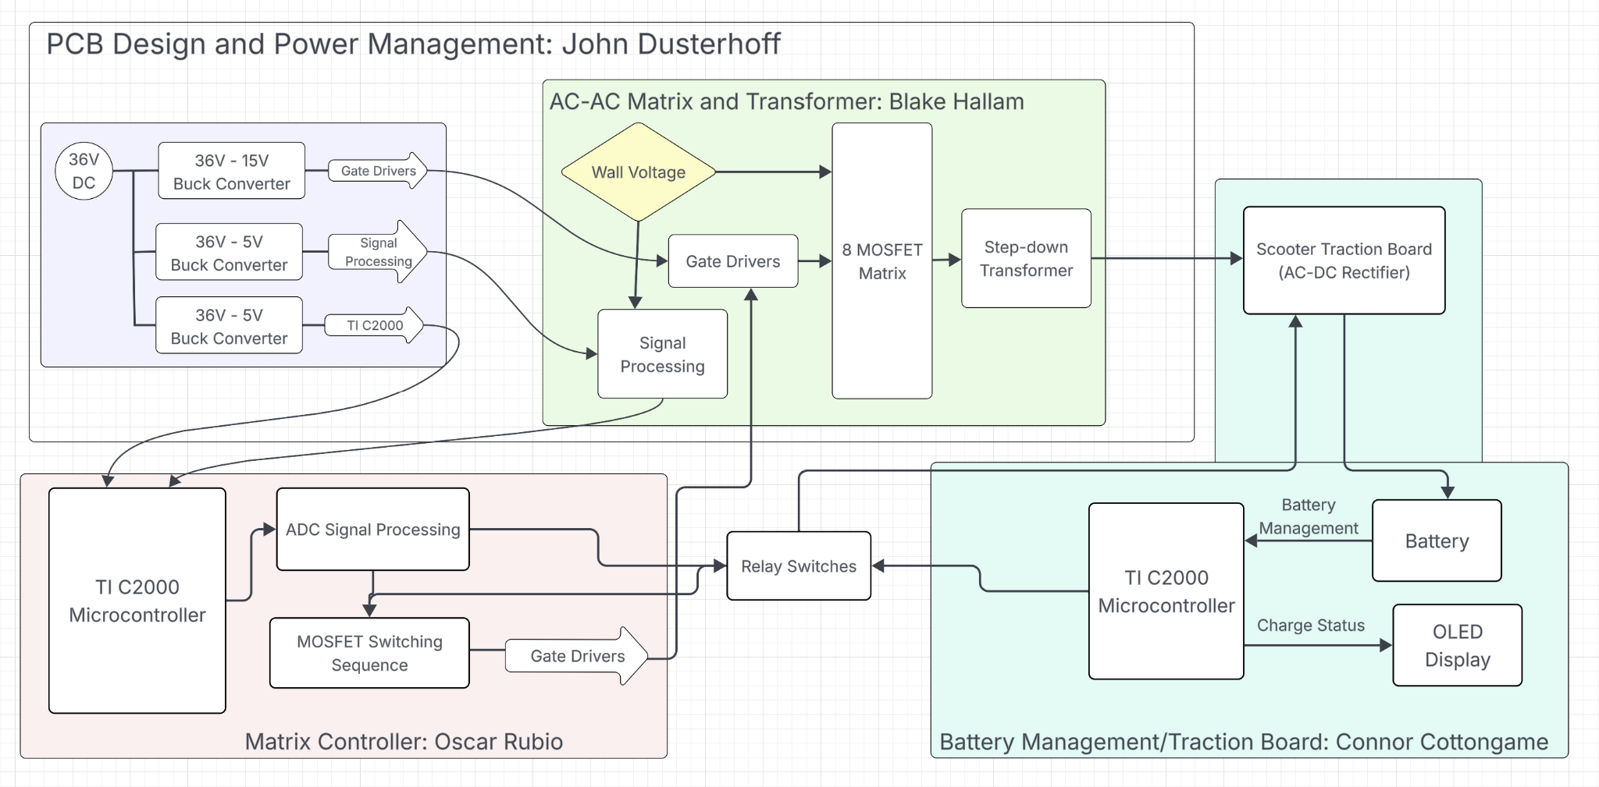
System Overview
Notes:
Cloud server and database

Slide 4
Project Timeline
Subsystem Designs and Updated and necessary testing (completed by 9/14) | Final subsystem testing and start integration (completed by 9/28) | Integration of MCU, signal processing and power stages (complete by 10/1) | Final Integration (to complete by 10/22) | Full System Testing (to complete by 11/5) | Full System Validation (to complete by 11/12) | Demo and Report (to complete by 12/5)

Slide 5
Signals & Power Conditioning
Blake Hallam
Accomplishments since midterm update 8 hours of work | Ongoing progress/problems and plans until the next presentation
Completed remaining component-level troubleshooting in preparation for subsystem integration: (1) diagnosed and corrected the voltage-divider circuit feeding the IsoAmp. (2) determined the required DC bias voltage for the IsoAmp, and (3) evaluated the RLC circuit before the transformer and determined it was not needed. Applied an input signal to the IsoAmp and verified the output in preparation for integration with Oscar’s ADC subsystem. | Integrate Oscar’s ADC subsystem with my subsystem, testing and verifying functionality. Order the remaining components needed to complete my subsystem. Ambitious goal: If all remaining components and the new PCB arrive within the next two weeks, solder and assemble all components onto the new board.

Slide 6
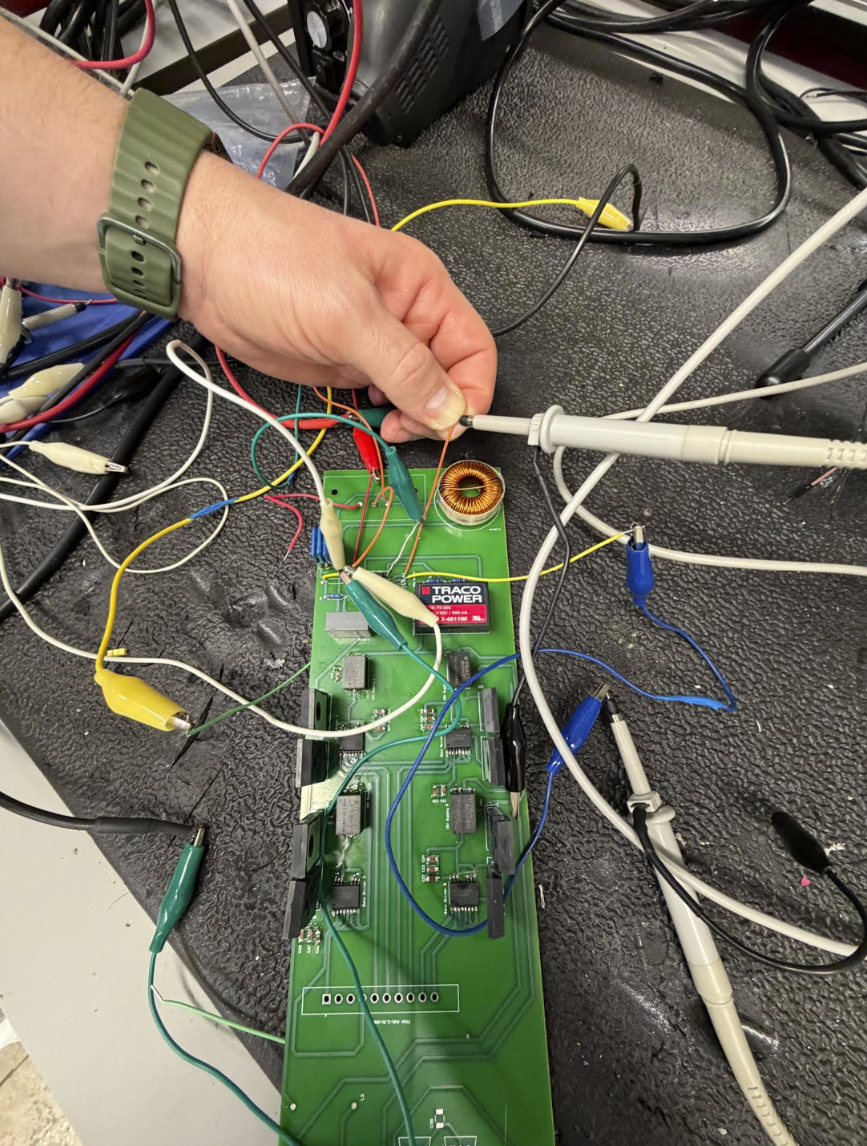
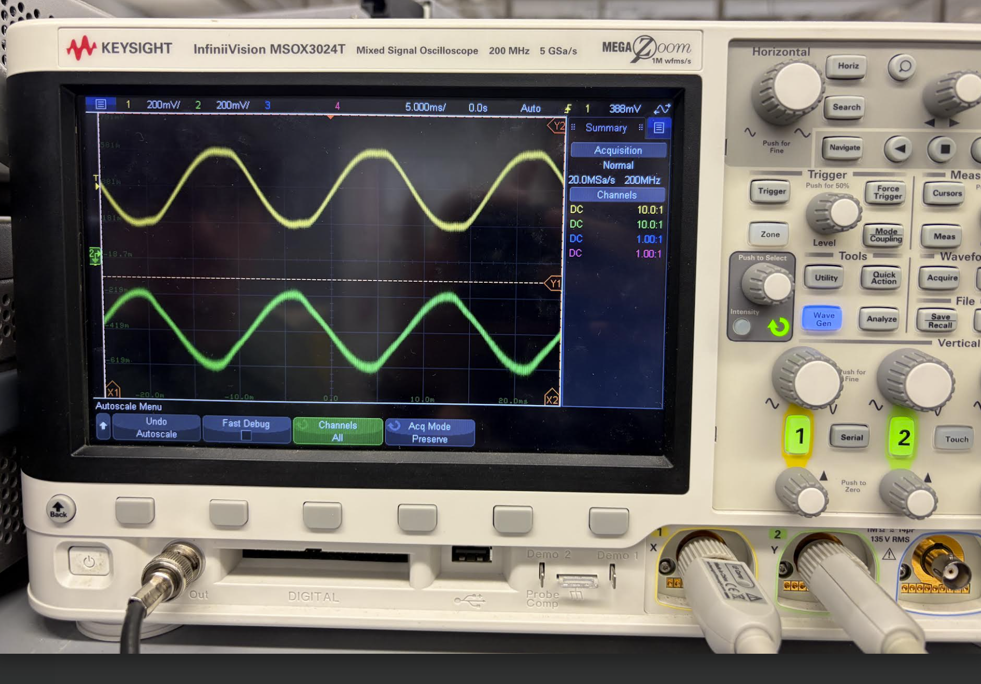
Signals & Power Conditioning
Blake Hallam

Slide 7
Matrix Control and Enclosure
Oscar Rubio
Accomplishments since first update 16 hrs of effort | Ongoing progress/problems and plans until the next presentation
Finished building the ADC program that connects to the Matrix Control Verified the output voltage from Isolation Amplifier is within the ADCs acceptable range Initial scooter body enclosure design (subject to change based on PCB 1 and 2 layout) | Continue to test and integrate ADC with Voltage signals coming from the Isolation Amplifier in Blake’s subsystem Integrate and test matrix control logic with gate drivers Continue to work on enclosure design and finalize sizing once all PCB dimensions are set

Slide 8
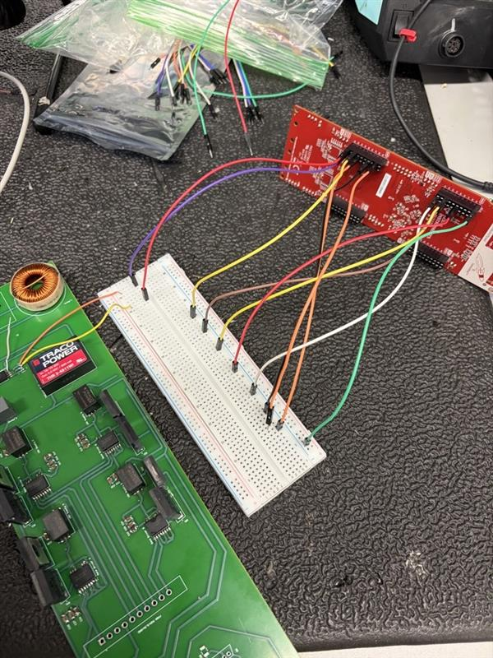
Matrix Control and Enclosure
Oscar Rubio

Slide 9
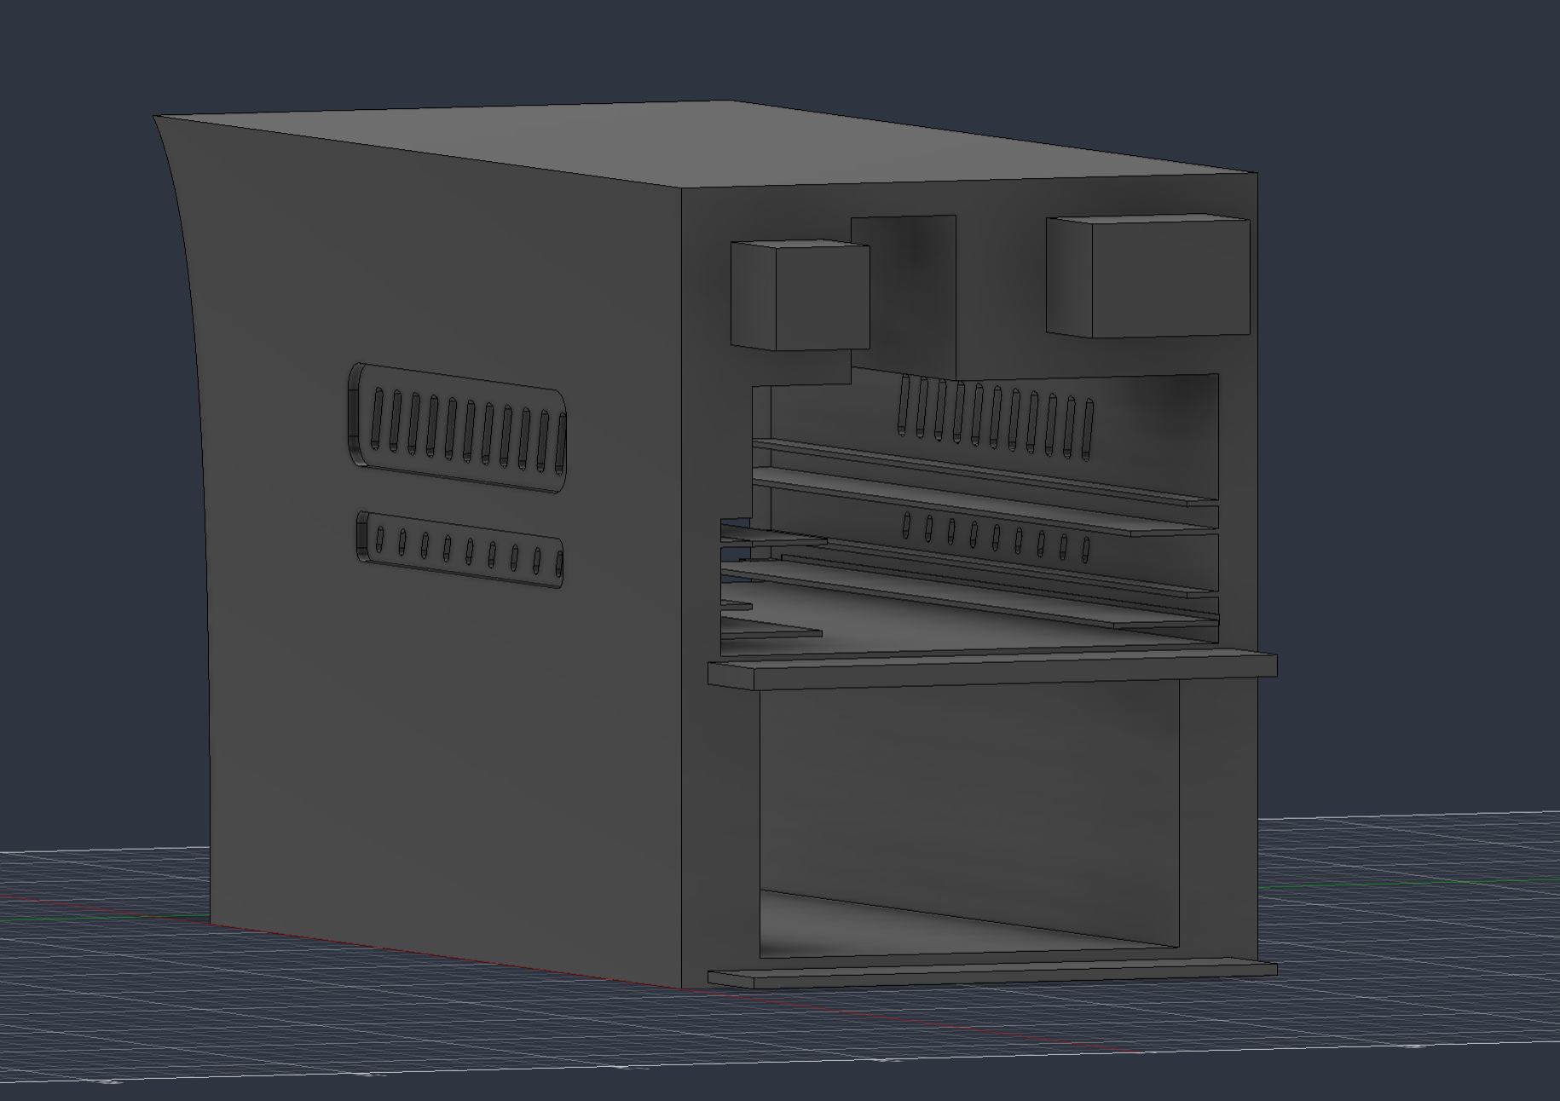
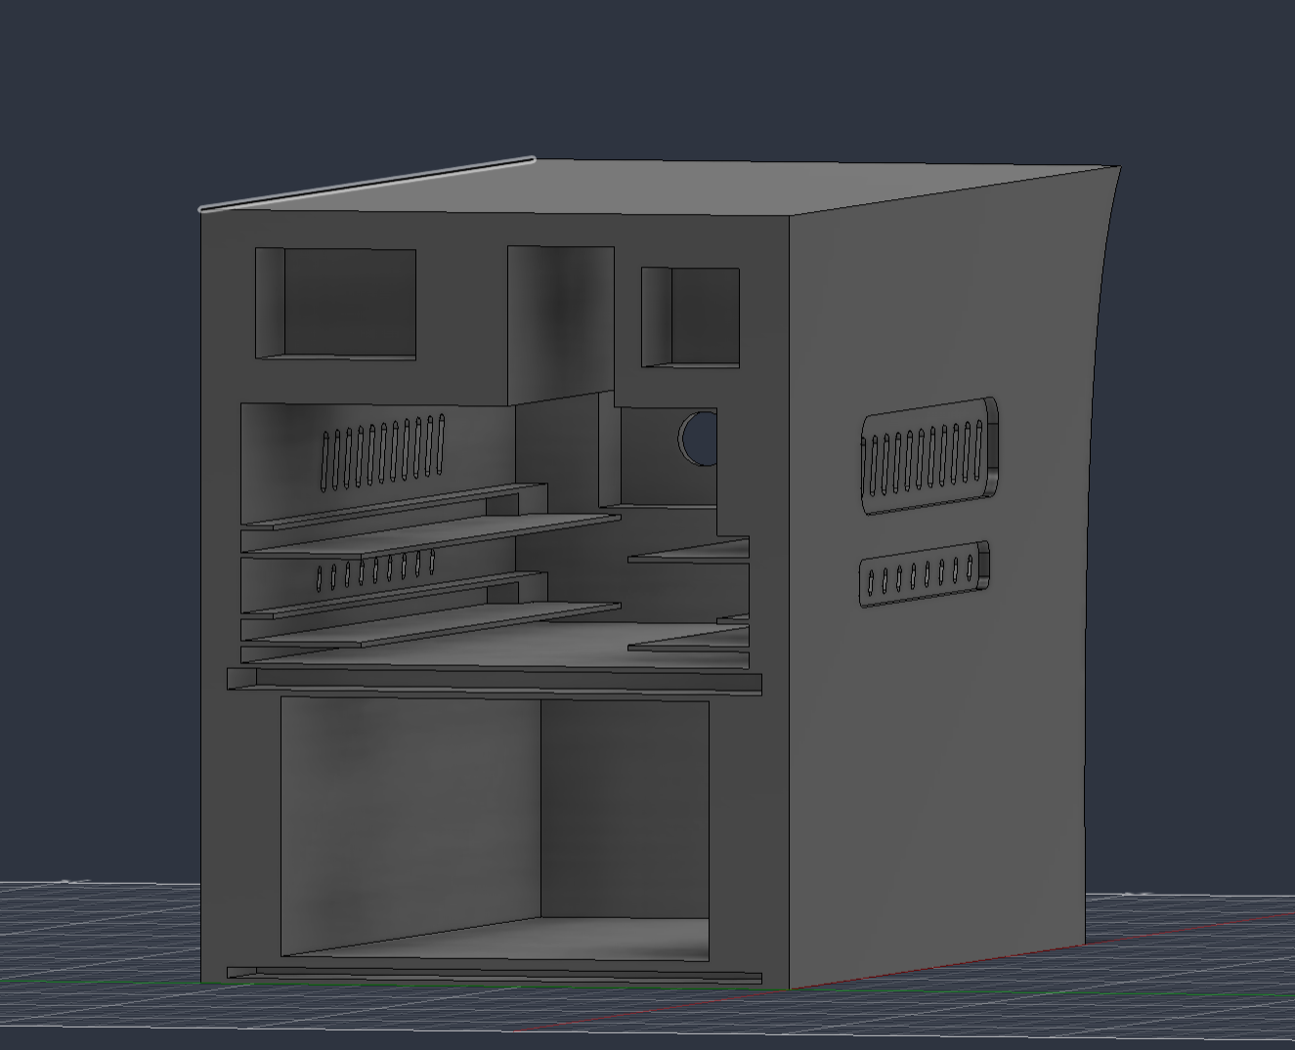
Matrix Control and Enclosure
Oscar Rubio

Slide 10
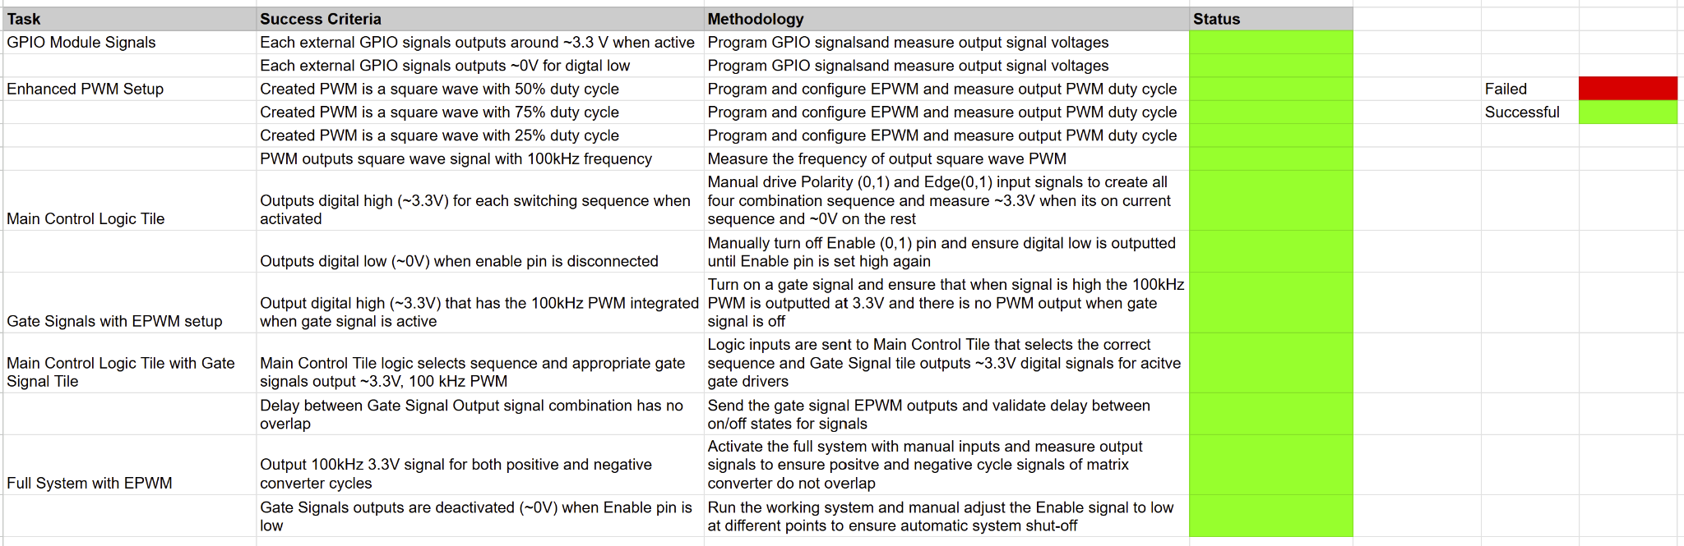
Matrix Control and Enclosure
Oscar Rubio
Matrix Control System Validation

Slide 11
PCB Design
John Dusterhoff
Accomplishments since first update 20 hrs of effort | Ongoing progress/problems and plans until the next presentation
PCB split into two pieces, a primary side which holds the controlCard and a secondary side PCB primary side finished with input and routing from the controlCard to the gate drivers, as well as other minor tweaks in circuit design | PCB Design V2 fully finalized and implementation started PCB soldered and beginning of testing and implementation

Slide 12
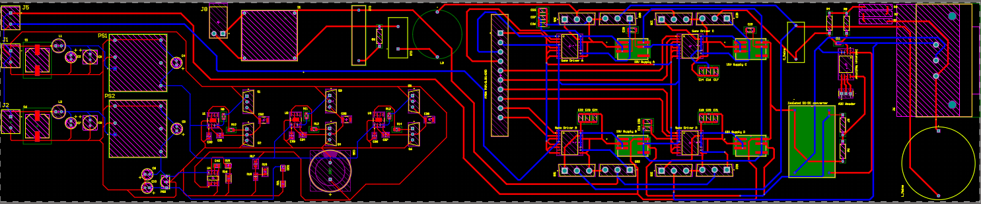
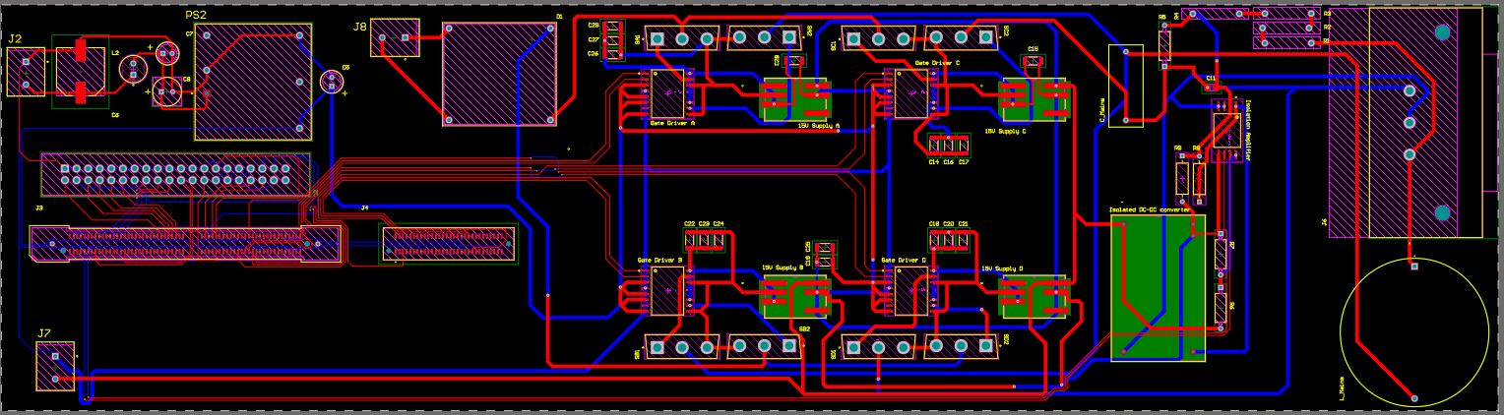
PCB Design
John Dusterhoff
Interesting figures related to your subsystem progress
Detail on what designed, built, tested

Slide 13
Charging Control Software, DAB Secondary / Inverter PCB
Connor Cottongame
Accomplishments 20 hrs of effort | Ongoing progress/problems and plans until the next presentation
Separate primary-side and secondary-side PCB Secondary-side: 3-phase motor controller; 12V, 5V, 3.3V supplies; motor position hall sensors; battery and per-phase current sensing; drive/charge mode relays. | Finish PCB and order this week Assemble PCB, run motor Validate charging before integration with primary side

Slide 14
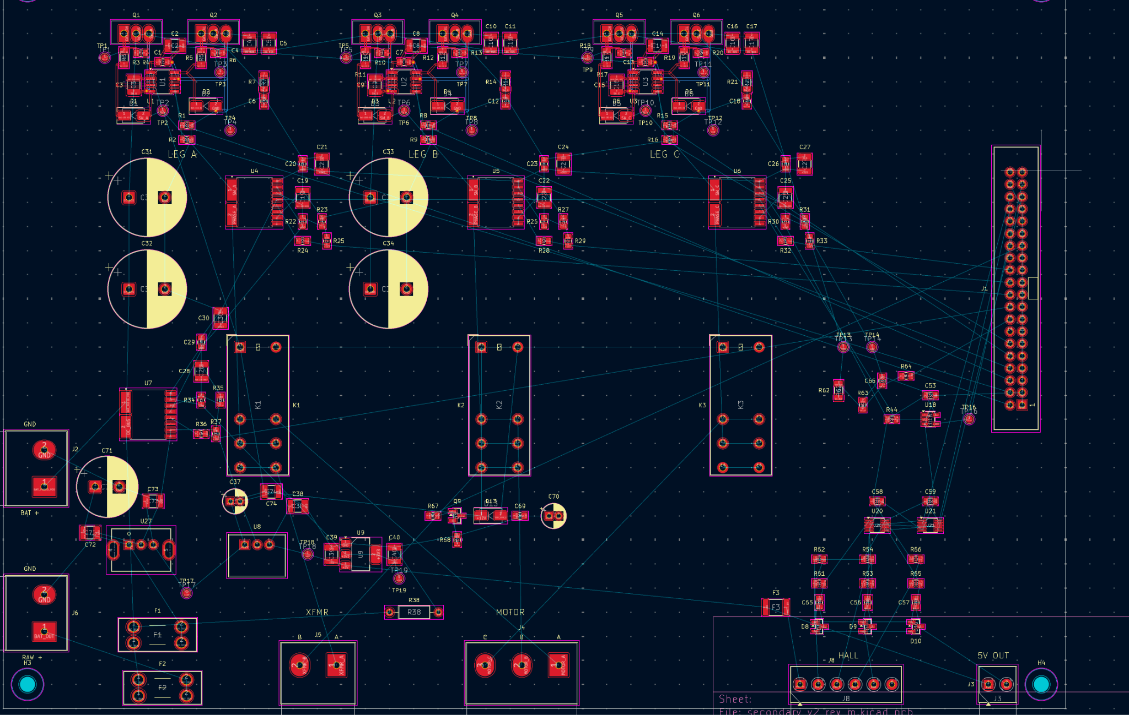
Charging Control Software, DAB Secondary / Inverter PCB
Connor Cottongame

Slide 15
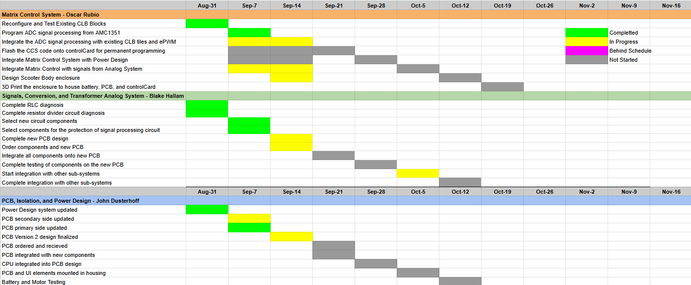
Execution Plan

Slide 16
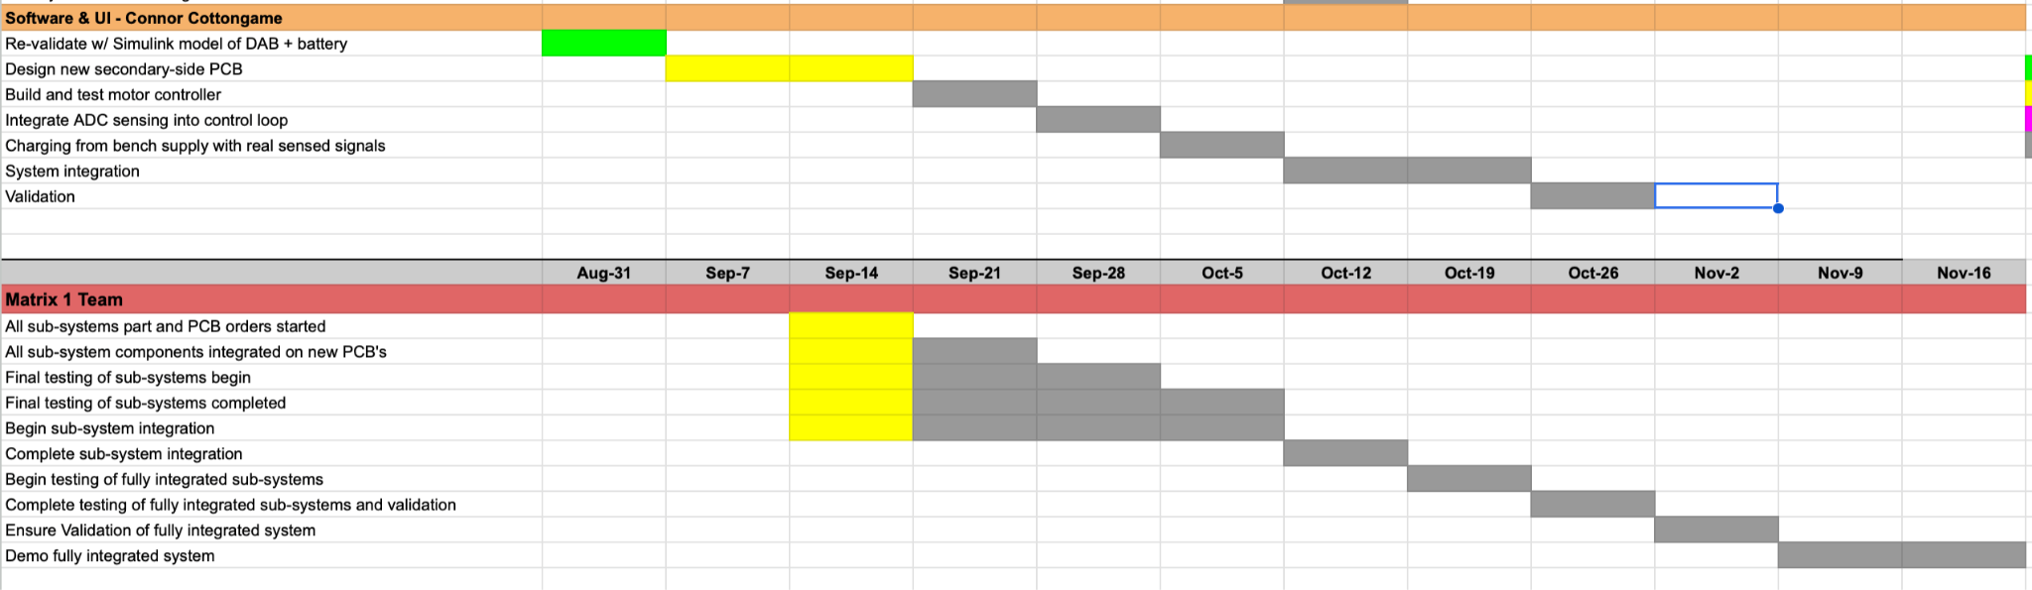
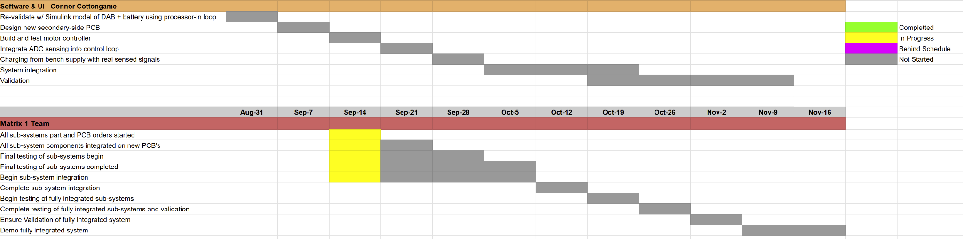
Execution Plan

Slide 17
Thank You For Your Time and Attention
Any Questions?
Matrix 1 / “Scooter Juice”
Connor Cottongame
John Dusterhoff
Blake Hallam
Oscar Rubio
TA: Sabyasachi Gupta
Sponsor: Prof Prasad Enjeti

